Slide 1
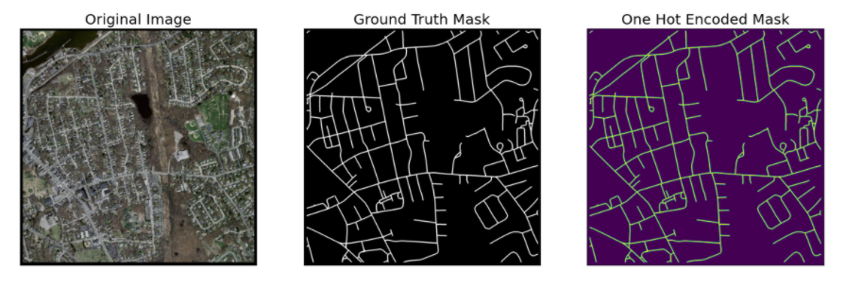
Road Segmentation
Team Members:
Gustavo Paz and Aniketh Suresh
Dataset:
Massachusetts Roads Dataset (https://www.kaggle.com/balraj98/massachusetts-roads-dataset)
Size: 10GB
Model: Deep Learning (ResNet50) on Amazon EMR

